Slide 1
Towards a U.S. Continuity Framework for Satellite Observations for Climate
Study Co-Chairs
Duane Waliser
NASA Jet Propulsion Laboratory
Betsy Weatherhead
U. Colorado (retired) and Jupiter Intelligence
Tapio Schneider
California Institute of Technology
Sun Climate Symposium
October, 2023
Flagstaff, AZ
Presented on behalf of the KISS Study Team
Notes:
We lost 3 of our comrades to COVID this week…. So for the EC folks, if you haven’t felt fuly deputized yet, consider yourself so deputized.

Slide 2
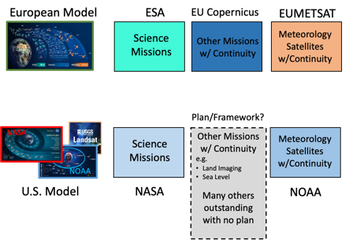
Questions for the U.S. Concerning Sustained Observations
Apart from weather, what are our national priorities for sustained Earth observations?
What paradigm will the U.S. use as the basis for setting these national priorities?
What organization or body will be chartered to develop these priorities for the U.S.?
What is our national approach to implementing sustained Earth observations that meet these priorities, including the information production and delivery services?

Slide 3
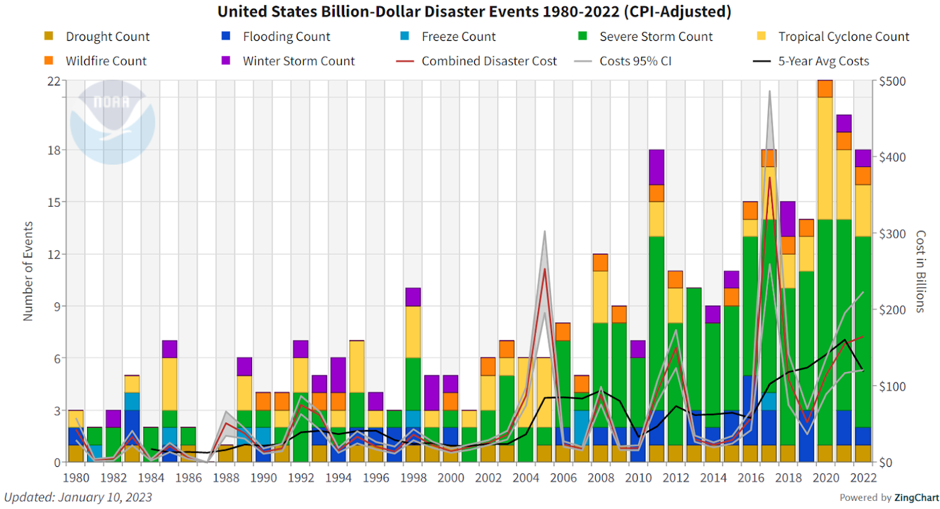
Damages From Climate-related Disasters Have Quadrupled Between 1980’s And 2010’s
~$150B annually in the U.S. alone
Climate.gov
Data: NCEI
There is growing urgency for improved public and commercial services to support a resilient, secure, and thriving U.S. population and economy, particularly in the face of mounting decision-support needs for environmental stewardship and hazard response, and for climate change adaptation and mitigation actions.
Notes:
Figure 1. The yearly count of billion-dollar weather disasters in the U.S. since 1980, adjusted for inflation. 2020 set a new record for the most such disasters in any year. The left axis and colored bars show the number of billion-dollar events for each year, with the color indicating the type of disaster. The right axis and colored lines show the disaster costs in billions of dollars – with the red line being the aggregate cost for the given year, the gray lines being 95% confidence limits, and the black line a running-5-year average cost. Source NOAA’s National Centers for Environmental Information.

Slide 4
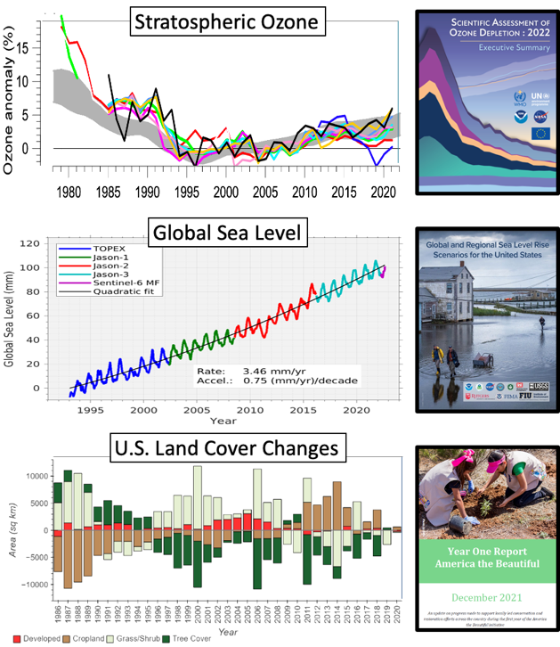
As with weather, significant science and societal benefits have been demonstrated from other long-record, satellite observations of the Earth
Many quantities measurable from satellites that have been shown to have scientific and/or decision-support value do not have a plan for sustained observations.*
*Examples include: precipitation, soil moisture, streamflow, snowpack, greenhouse gas concentrations and emissions, stratospheric ozone, radiation budget, aerosol/cloud profiles, ocean salinity and surface winds.
Notes:
Figure 2. (top) Satellite observations of northern mid-latitude (35-60oN) stratospheric ozone (at around 42 km or 2 hPa) from multiple satellite or satellite-infused sources (AMS-Climate, 2022) and the cover of the 2018 quadrennial review from the Scientific Assessment Panel of the Montreal Protocol (WMO-Ozone, 2022) for which the satellite data are used. (middle) Satellite observations of global sea level rise from a sequence of nearly identical instruments flown on five different satellites (courtesy, J. Willis/JPL/NASA) and the cover from the 2022 U.S. Interagency Sea Level Rise Technical Report (Sweet et al. 2022) for which the satellite data used. (bottom) Landsat satellite observations of U.S. land cover change from 1986 to 2020 based on the Land Change Monitoring, Assessment, and Projection (LCMAP) project (Plot courtesy of LCMAP/USGS EROS) and the cover of the first annual America the Beautiful report (https://www.doi.gov/priorities/america-the-beautiful), where land cover change is a chapter based on Landsat observed landscape changes, and their drivers such as climate change, water availability, disturbance, etc.

Slide 5
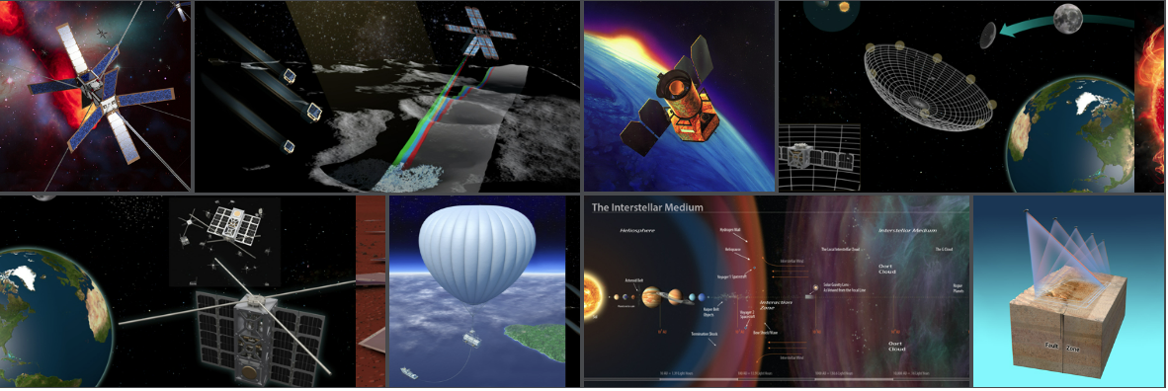
The Keck Institute for Space Studies (KISS) was established at the Caltech in January 2008 with a $24 million grant over 8 years from the W. M. Keck Foundation.
The Institute is a "think and do tank," whose primary purpose is to bring together a broad spectrum of scientists and engineers for sustained technical interaction aimed at developing new space mission concepts and technology.
The Institute is centered on the intellectual, instrumentation, and research strengths of the Caltech Campus and JPL — and augments those strengths by inviting external experts from academia, government, and industry to engage in its programs.

Slide 6
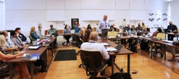
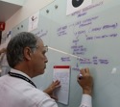
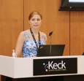
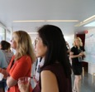
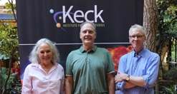
Study Participants
Waleed Abdalati - University of Colorado Boulder
Nancy Baker - Naval Research Laboratory
Stacey Boland – Jet Propulsion Laboratory/Caltech/NASA
Michael Bonadonna - National Environmental Satellite, Data, and Information Service, NOAA
Carol Anne Clayson - Woods Hole Oceanographic Institution
Belay Demoz - University of Maryland, Baltimore County
Kelsey Foster – Stanford University
Christian Frankenberg - Caltech
Maria Hakuba – Jet Propulsion Laboratory/Caltech/NASA
Therese Jorgensen - NASA Ames Research Center
Ryan Kramer - University of Maryland, Baltimore County/NASA Goddard Space Flight Center
Daniel Limonadi – Jet Propulsion Laboratory/Caltech/NASA
Anna Michalak - Carnegie Institution for Science/Stanford University
Asal Naseri - Space Dynamics Laboratory
Pat Patterson - Space Dynamics Laboratory
Peter Pilewskie - University of Colorado Boulder
Steven Platnick - NASA Goddard Space Flight Center
Charlie Powell – University of Michigan / NOAA
Jeff Privette - NOAA's National Centers for Environmental Information
Chris Ruf - University of Michigan
Tapio Schneider - Caltech
Jörg Schulz - European Organization for the Exploitation of Meteorological Satellites (EUMETSAT)
Paul Selmants - U.S. Geological Survey
Rashmi Shah – Jet Propulsion Laboratory/Caltech/NASA
Qianqian Song – University of Maryland, Baltimore County
Graeme Stephens – Jet Propulsion Laboratory/Caltech/NASA
Timothy Stryker - USGS National Land Imaging Program
Wenying Su - NASA Langley Research Center
Mathew Van Den Heever – University of Colorado
Anna Veldman – UCLA
Duane Waliser – Jet Propulsion Laboratory/Caltech/NASA
Elizabeth Weatherhead - Jupiter Intelligence and University of Colorado Boulder
+
9 on or previously on CESAS and/or 2017 ESAS Decadal Survey
7 Early Career members
4 NASA Centers, 3 NOAA, 2 USGS, Navy, Universities, EUMETSAT, GCOS/CEOS, small sats, etc.

Slide 7
Selected for the 2022 KISS Study Program
Towards a U.S. Framework for Continuity of Satellite Observations of Earth’s Climate and for Supporting Societal Resilience
KISS Study Proposal
The goal of this study program is help accelerate discussions and plans for a greater and more impactful U.S. contribution to the global climate observing system. In this context, “climate” includes observations that support climate science and process understanding, as well as monitoring for situational awareness, climate services, impact response, adaptation, and mitigation assessments.
2026-27
2027 ESAS
Decadal Survey
2024
2023
2017 ESAS DS
Mid-term Outcome
KISS Study Outcome
Aspiration: Aid/support the anticipated upcoming NASEM discussions regarding satellite-based climate observing system
KISS Proposal : Figure 2
Study Website
https://kiss.caltech.edu/programs.html#satellite_observations

Slide 8
Towards a U.S. Framework for Continuity of
Satellite Observations of Earth’s Climate
and for Supporting Societal Resilience
Study Timeline
KISS Continuity Study Team, Towards a U.S. Framework for Continuity of Satellite Observations of Earth’s Climate and for Supporting Societal Resilience, Earth’s Future, American Geophysical Union, (To be) Submitted with minor revisions 10/25/2023

Slide 9
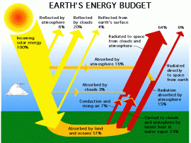
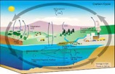
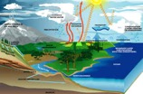
KISS Study Approach
Energy Cycle & Resources
?
+
t
t+10 yrs
t+20 yrs
Carbon Cycle & Resources
?
+
Water Cycle & Resources
3) How to sustain & impact?
?
Stewardship and Implementation: Consider data flow infrastructure and operations, calibration & validation, uncertainty quantification and traceability, data stewardship best practices, dissemination.
2) How to include?
1What to include?
Architecture Approaches/Configurations: Consider approaches to architecture design and development, including “new space” and technology advances, commercial data, and international considerations.
Observation Priorities Consider approaches to identify and prioritize satellite observables that should be sustained to support Science and Decision Support
Notes:
Figure 3. KISS Study Team’s three pillar approach to the Continuity Study focused on 1) Why & What to Include, 2) How to Include, and 3) How to impact and sustain? These 3 topics are discussed in Sections 2, 3 and 4, respectively. The upper portion of the diagram utilizes water, carbon and energy as a simple means to represent the breadth of Earth processes of interest, noting that each contains science and application targets, and that each of these includes many underlying and interacting quantities.

Slide 10
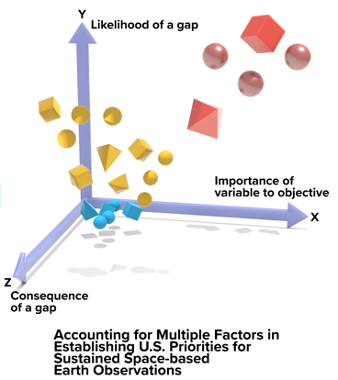
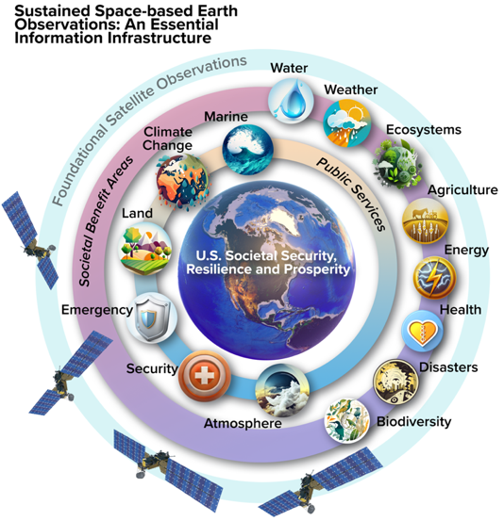
Start with Identifying and Prioritizing Sustained Observation Needs for the U.S.
Example Framework To Highlight Multi-Dimensional Considerations for Sustained Observation Priorities
Findings 2.1 & 2.2
Prioritization of variables with U.S. needs in mind will:
require a mix of objective and subjective considerations across multiple societal sectors, public services and Earth/climate science areas.
depend on changing societal needs, technology advances and programmatic opportunities – and thus need to be periodically revisited
c.f. 2015 NASEM Study on Continuity – Value Framework for Science and “QESOs”
Notes:
Figure 4. A framework to identify and prioritize sustained space-based Earth observations. This framework considers information for a sampling of Societal Benefit Areas (SBA) to provide public and/or commercial services in support of U.S. resilience, prosperity and national security, while continuing foundational observations to support advancing Earth and climate sciences (left). In prioritizing sustained Earth observation variables, considerations may include, among other factors, their importance to national objectives, likelihood of a gap, and consequence of a gap for each service and/or SBA considered (right). Earth observation variables are represented by the different “dots”, with different symbol types (e.g. cube, sphere) depicting different SBAs or services, and the different colors represent priority for continuity. Variables that are furthest from the origin for all three axes (i.e. red color) indicate higher priority for continuity.

Slide 11
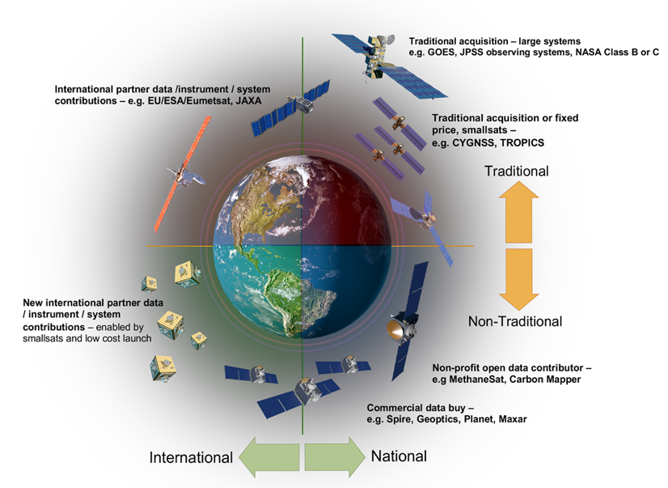
“NewSpace”, Commercial, NGO & International Interests Expand our Options for Continuity
Findings 3.1 & 3.2
Lower cost of access to space is increasing the sources able to contribute elements to the Earth observing system.
These sources include traditional government agencies, international partners, commercial entities with data purchases, NGOs and non-profit, and hybrid solutions
Future U.S. coordination mechanisms for Earth observations should be designed to fully take advantage of these types of contributions .
Notes:
Figure 4. Schematic illustration of a hybrid space architecture (HSA) that provides multiple new dimensions of opportunities for sustained space-based observations of essential climate and other environmental variables. The upper(lower) part of the diagram includes traditional(non-traditional) approaches to Earth science and application mission implementation, while the left(right) side of the diagram denotes the international(national) approaches to mission implementation. This four-quadrant view highlights the opportunity space for implementation of sustained observations. In this depiction, the priorities and capabilities of individual nations are combined to produce global observations not otherwise possible, and large, government sponsored missions are combined with non-profit and commercial data products to deliver sampling densities not otherwise affordable. An efficient and effective HSA will adjust the boundaries between these four quadrants to optimize the strengths of each.

Slide 12
Leveraging “NewSpace”, the Latest Technologies, Commercial and NGO Opportunities
Table 1. Summary of current and potential future acquisition & support models
Approach | Description | Risk Owner | Data Distribution | Examples
Traditional | Government full specification of system, launch, operations, data processing and distribution. Typically, cost-plus contracts. Note that it is not uncommon for existing traditional project implementations to have foreign partner contributed elements to help achieve mutual objectives at a lower cost than a single country paying for the full mission. | Government | Government fully owns the data and is typically unrestricted | NOAA GOES, & NPSS; NASA-USGS Landsat; NASA science missions Example partner contributions for NASA research missions include launches, instruments, spacecraft buses, and ground system elements.
Complete System Contributed by Foreign Partner | A foreign government contributes a needed observing system, either as a single system, or as a long-term commitment of sustained observations for the given variable(s). This can relieve the need for other countries to make the same measurement, or at a minimum help meet some of the observing requirements and therefore likely reduce the overall cost to the U.S. if any residual / complementary observing systems are still needed. | Foreign Government (but other users depending on this contribution also suffer consequences if it fails) | Depends on foreign partner – European Union and Japan generally have unrestricted open data policies. New foreign partners would be strongly encouraged to make their data openly available. | International weather satellite contributions and coordination through WMO-CGMS. Copernicus Sentinel System free and open Earth observation data contributions. JAXA free and open Earth observation data contributions. The Qatar Foundation is interested contributing important ice and ground penetrating radar observations.
Fixed price for service | Government specifies the data or service desired, not how they are delivered. Competes fixed price contracts for service delivery. Contractor is expected to invest some of its own resources and may be able to sell the same services to others once developed. | Shared between government and contractor | Data could be either open or restricted, depending on long term cost share. | No existing example for remote sensing. NASA commercial cargo and crew programs are similar examples in human exploration.
Data buy - with upfront promise or down payment investment by government | Government invests money upfront in company business model, potentially via competition, but long-term funding is expected to come from NGOs. | Shared between government and vendor | Typically, data is somewhat restricted, with the data vendor needing an opportunity to make additional money off data sales unless higher prices for the data are an option. | NASA example - SeaWiFS 1997-2007; DOD examples - Orbital Sidekick hyperspectral imaging constellation has In-Q-Tel and AFVentures’s Strategic Financing program investment funding.
Data buy – with no upfront promise by government | Government is not involved in system specification or operation. Government does not provide upfront investment or data buy guarantees. Government only buys data after it is available and makes it available to its user community. | NGO | Typically, data is restricted - each user generally must buy its own copy of the data; There may be future funding models where data is openly distributable after purchase, but at a higher price. The latter might be an option for data whose profit utility is low after long latency (e.g., old weather data). | NOAA Commercial Data Program; NASA Commercial Smallsat Data Acquisition (CSDA) program commercial data distribution models of Maxar, Planet, Capella, IceEye, and others, with substantial National Reconnaissance Office data buys.
Public/Private Partnership: Philanthropy-seeded partnership | Philanthropy pays for technology development and initial prototype spacecraft, arranges for technology transfer / licensing to production partner. Production partner deploys, operates, and maintains systems. | Philanthropy | Mix of open and restricted data. For Carbon Mapper the GHG (Co2 and CH4) data will be open access. Other hyperspectral data and products will be sold by Planet to fund the constellation. | Carbon Mapper - University of Arizona, Planet, NASA/JPL, mix of philanthropies and NGOs.
Non-profit funded system | NGO (typically a non-profit working with one or more philanthropies or other partners) fully funds the development of observing and data distribution system. | NGO & funding partners | Data is open. | MethaneSat - Environmental Defense Fund, New Zealand Space Agency.

Slide 13
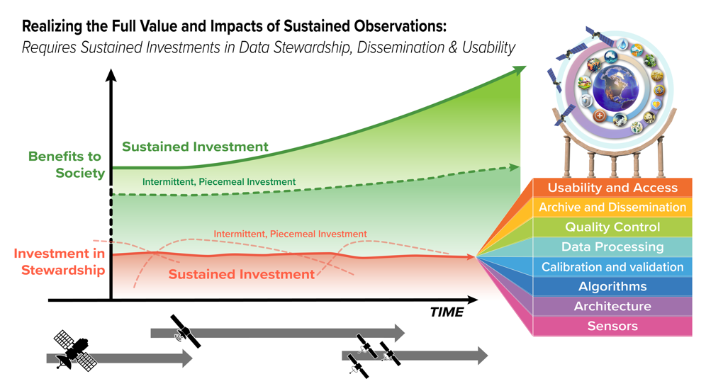
Sustained Observing Systems Yield Sustained Science & Societal Benefits
Finding 4.1 - 4.3
A framework for successful stewardship of sustained Earth observations requires: a) end-to-end planning with a long-term horizon in mind, b) a suite of technical attributes and platforms that support open and easy access, c) interoperability of related observations, d) carefully coordinated and sustained programmatic structures that provide the needed shepherding and support, etc.
Notes:
Figure 6. A U.S. framework for carefully coordinated, end-to-end stewardship will increase the value of past, current and future Earth observations for all Americans. Sustained Earth observations, made up of evolving spacecraft and sensors, are represented by the gray bars at the bottom. Key elements of modern data stewardship is represented by the multi-color shaded box. The benefits to society, supported by the sustained observations and stewardship elements, are represented by the green lines and the simplified form of the societal benefit graphic from Figure 4. Red (green) lines represent investments in (societal benefits from) data stewardship. Solid (dotted) lines represente sustained (intermittent, piecemeal) investments in stewardship.

Slide 14
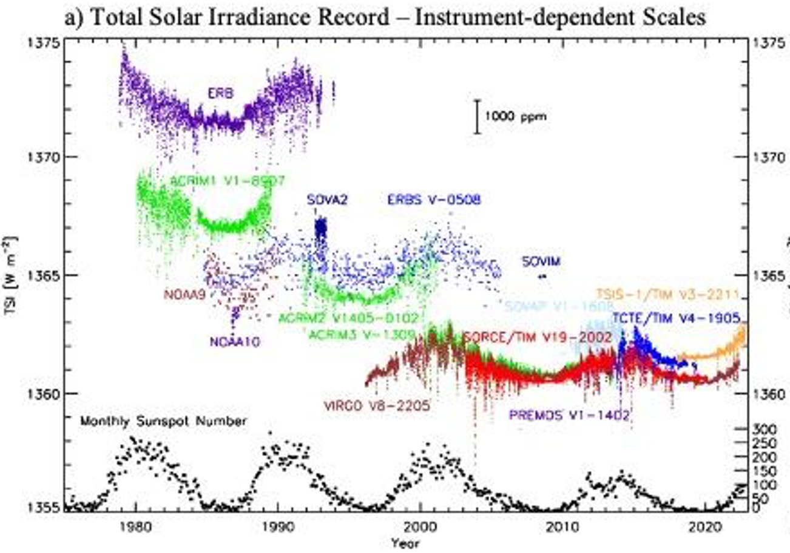
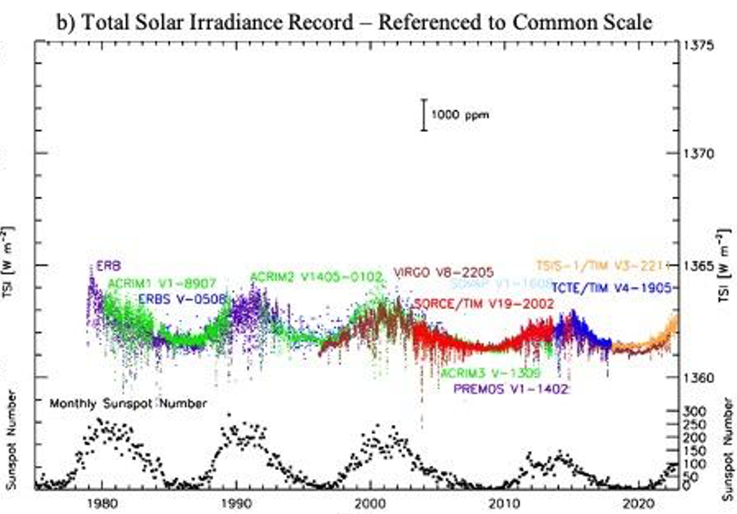
Data Stewardship, Information Production, Dissemination & Use
Table 4.1. Key elements of the data production value chain of satellite-based Earth observations.
Data Production Elements | Critical Continuity Considerations
Sensor Technology and Characteristics | Representativeness of the sensor measurements (e.g., spectral channels, sampling, etc.) Known sensor characteristics and uncertainties
Satellite Observing System Architecture | Time-of-day or viewing geometry impacts Stability of satellite orbit Swath width and revisit rate Launch cadence and gap risk posture
Algorithm Development, Updates, Documentation | Commonality in radiometric and geophysical algorithms (e.g., forward radiative models and inversion techniques, ancillary datasets, etc.)
Calibration and Validation | Documentation of calibration techniques, inclusive of pre-launch characterization and on-orbit characterization Consistency across validation protocols and ground truths
(Re-)Processing Demands and Cadence | Consistent geolocation and grids Lineage and preservation of original (i.e. Level 1) data for retrospective reprocessing Compute, storage and access capability for re-processing Compute, storage and access capabilities for utilizing data from multiple missions and programs.
Data and Information Product Quality Control | Documentation and evaluation of systematic impacts from the chosen filtering approaches Uncertainty quantification and traceability for data products
Data Archive and Dissemination | Management of interfaces under common APIs Common data and metadata formats Provenance tracking Unique digital object identifier
Usability and User Ecosystem | Co-location of data across missions, timeseries, and programs Curation of community access and development tools Interoperability of use across different observation types Permissive licensing regimes for commercially acquired datasets
Example highlighting Importance of Data Production Elements of Stewardship
Figure 4.2. An example of the importance of climate observation continuity. The figure on the left shows incoming radiative energy from the Sun, a fundamental climate data record, from the set of space-based measurements since 1978. The measurements are shown at each instrument’s native calibration scale. Because the individual observation records overlap, it enables the construction of the composite record on the right where all measurements are on a common scale. This helps reveal trends in the long-term data record that may have impacts on climate. Figure from G. Kopp (https://spot.colorado.edu/~koppg/TSI/),

Slide 15
Path Forward and Next Steps
Findings 5.1 and 5.2
The U.S. could benefit from a systematic and overarching plan or framework for identifying, prioritizing, funding, and implementing sustained Earth observations that are critical for supporting our nation’s science, policy, and societal resilience goals.
A clear and unified approach to sustained Earth observations and determination of our national priorities for these observations may improve the effectiveness of the varied U.S. investments in Earth observations and associated information systems. Such an approach may also enable the United States to play a larger global leadership role in environmental stewardship, Earth system and climate science, and related public services
Formal KISS Study Completed in the Spring of 2023
KISS Continuity Study Team, Towards a U.S. Framework for Continuity of Satellite Observations of Earth’s Climate and for Supporting Societal Resilience, Earth’s Future, American Geophysical Union, (To be) Submitted with minor revisions 10/25/2023
The team is organizing ‘Continuity’ sessions at AGU’22 and AMS’23.

Slide 16
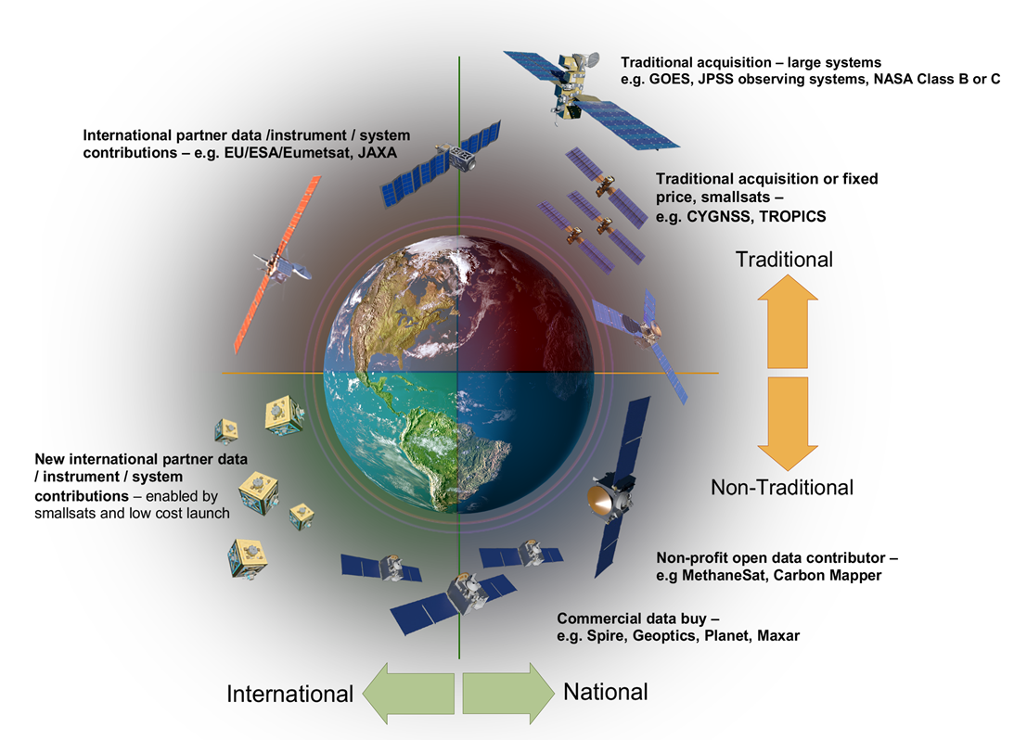
Towards a U.S. Framework for Continuity of Satellite Observations of Earth’s Climate and for Supporting Societal Resilience
Step 1
Step 2
Step 3
Accounting for Long-term Programmatic and Technical Support
Identifying Science and Application Priorities
Developing Architecture Approaches & Opportunities
A key first step is developing a U.S. programmatic home/entity to shepherd these steps and realize the intended outcomes.

Slide 17
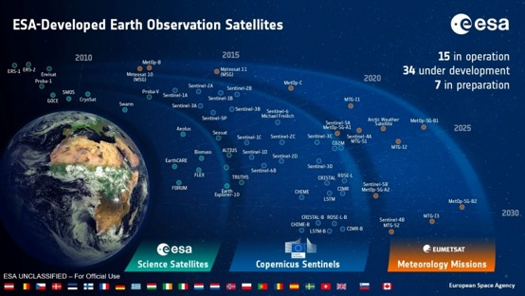
European Union’s Answer
Copernicus is the EU’s Earth observation program that looks “at our planet and its environment to benefit all European citizens. It offers information services that draw from satellite Earth Observation and in-situ data…to help service providers, public authorities, and other international organizations improve European citizens' quality of life and beyond.
The satellite component of Copernicus is based on a series of “Sentinel” missions which are developed to provide the observations needed to deliver the public benefits of the Copernicus Programme – which are provided in the form of Atmosphere, Marine, Land, Emergency, Climate, and Security Services.

Slide 18
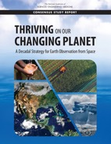
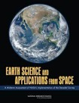
2017 Earth Science and Applications from Space Decadal Survey
Recommendation 2.2: NASA—with NOAA and USGS participation—should engage in a formal planning effort with international partners (including, but not limited to ESA, EUMETSAT, and the European Union via its Copernicus Program) to agree on a set of measurements requiring long-term continuity and to develop collaborative plans for implementing the missions needed to satisfy those needs. This effort to institutionalize the sustained measurement record of required parameters should involve the scientific community, and build on and complement the existing domestic and international Program of Record.
Recommendation 4.6: NASA ESD should employ the following guidelines for maintaining programmatic balance:
New Measurements versus Data Continuity. Lead development of a more formal continuity decision process (as in NASEM, 2015) to determine which satellite measurements have the highest priority for continuation, then work with U.S. and international partners to develop an international strategy for obtaining and sharing those measurements.
Recommendation 4.7: NASA should make the following scope changes to its program elements:
Technology Program. Establish a mechanism for maturation of key technologies that reduce the cost of continuity measurements.
2007 Recommendation: The Office of Science and Technology Policy, in collaboration with the relevant agencies and in consultation with the scientific community, should develop and implement a plan for achieving and sustaining global Earth observations.
Notes:
RashmiRecommendation: The Office of Science and Technology Policy, in collaboration with the relevant
agencies
and in consultation with the scientific community, should develop and implement a plan for
achieving and sustaining global Earth observations. This plan should recognize the complexity of differing
agency roles, responsibilities, and capabilities as well as the lessons from implementation of the Landsat,
EOS, and NPOESS programs.

Slide 19
Towards a U.S. Framework for Continuity of Satellite Observations of Earth’s Climate and for Supporting Societal Resilience
LIST OF FINDINGS – SLIDE 1 OF 4
1 Introduction
Finding 1.1 - There is growing urgency for improved public and commercial services to support a resilient, secure, and thriving U.S. population and economy, particularly in the face of mounting decision-support needs for environmental stewardship and hazard response, and for climate change adaptation and mitigation actions (e.g. FFAPCS, 2023).
Finding 1.2 - Space-based Earth observations represent an essential component of the infrastructure needed to support the delivery of critical environmental science and decision-support information with local, national, and global utility.
Finding 1.3 - Many quantities measurable from satellites that have been shown to have scientific and/or decision-support value do not have a plan for sustained observations.
Finding 1.4 - The U.S. does not have a systematic, overarching plan or framework for identifying, prioritizing, funding, and implementing additional sustained Earth observations to support our nation’s science, policy, and societal resilience goals.

Slide 20
Towards a U.S. Framework for Continuity of Satellite Observations of Earth’s Climate and for Supporting Societal Resilience
LIST OF FINDINGS – SLIDE 2 OF 4
2. Identifying and Prioritizing Sustained Observation Needs
Finding 2.1 - Prioritization of variables requiring continuity of satellite observations is complex and may benefit from consideration across multiple societal sectors and services. The technical requirements on these observations (e.g., temporal and spatial sampling, accuracy, latency) are highly dependent on the specific application sector and/or the underlying supporting science objectives.
Finding 2.2 - Any prioritization framework will: a) have subjective elements, b) be time and context dependent due to changing science and societal benefit needs, technological advances and programmatic opportunities, and c) will likely benefit from periodic reexamination.
3 Satellite Observing Architectures: Technology, “NewSpace”, Commercial and NGO Considerations
Finding.3.1 One impact of the lower cost of access to space is that many new domestic (e.g., NGOs such as Carbon Mapper and MethaneSat) and international entities (e.g., countries that want to help address climate change that previously could not afford to) are able to contribute elements to the Earth observing system. Future U.S. and international coordination mechanisms for Earth observations could be designed to fully take advantage of these types of contributions.
Finding.3.2 Sources of new missions and observing capabilities to address unmet U.S. needs for continuity of Earth observations could be obtained from traditional government acquisition, international partners, commercial entities, NGOs, data purchases, and hybrid solutions (i.e. Table 1).

Slide 21
Towards a U.S. Framework for Continuity of Satellite Observations of Earth’s Climate and for Supporting Societal Resilience
LIST OF FINDINGS – SLIDE 3 OF 4
4 Data Stewardship and Information Production, Usability and Dissemination
Finding 4.1 - A framework for successful stewardship of sustained Earth observations requires end-to-end planning with a long-term horizon in mind (i.e., well beyond individual satellite mission lifetimes), a suite of technical attributes that support open and easy access, interoperability of related observations, as well as carefully coordinated and sustained programmatic structures that provide the needed shepherding and support.
Finding 4.2 - For climate datasets, the value to science and society accrues with longevity, so stewardship and the necessary technical and programmatic structures needed to support it, require an enduring commitment that should be independent of individual missions. Investing in data usability, traceability, provenance, and interoperability capabilities can greatly enhance the return on the given civil or commercial investments made to deploy the observing system (Figure 6).
Finding 4.3 – While strides have been made by individual U.S. agencies to provide more ready access to Earth observation datasets, full exploitation of the data and associated investments for U.S. civil and commercial interests and services suggests a more holistic stewardship approach providing the means for platforms where observations and models reside together in an easily accessible and manipulatable form and the latest analysis techniques, such as machine learning and artificial intelligence, can be applied to entire observational records.

Slide 22
Towards a U.S. Framework for Continuity of Satellite Observations of Earth’s Climate and for Supporting Societal Resilience
LIST OF FINDINGS – SLIDE 4 OF 4
5 Summary and Path Forward
Finding 5.1 The U.S. could benefit from a systematic and overarching plan or framework for identifying, prioritizing, funding, and implementing sustained Earth observations that are critical for supporting our nation’s science, policy, and societal resilience goals.
Finding 5.2 A clear and unified approach to sustained Earth observations and determination of our national priorities for these observations may improve the effectiveness of the varied U.S. investments in Earth observations and associated information systems. Such an approach may also enable the United States to play a larger global leadership role in environmental stewardship, Earth system and climate science, and related public services

